Slide 1
Apache Kafka Fundamentals

Slide 2
Agenda
Kafka fundamentals
Kubernetes (K8s) fundamentals
Kubernetes operator
Strimzi overview
Kafka on Kubernetes using Strimzi
Demo

Slide 3
What is Kafka?
Apache Kafka is an open-source distributed event streaming platform developed by LinkedIn and later handed over to the Apache Software Foundation. It is designed for high-throughput, fault-tolerant, and real-time data streaming.
At its core, Kafka is a distributed publish-subscribe messaging system. Data is written to Kafka topics by producers and consumed from those topics by consumers. Kafka topics can be partitioned, enabling the parallel processing of data, and topics can be replicated across multiple brokers for fault tolerance.

Slide 4
Key Features
Low Latency: It ensures that messages are delivered to consumers with minimal delay, enabling timely insights and actions.
Horizontal Scalability: Kafka scales horizontally by adding more brokers to the cluster, allowing it to handle increasing data volumes and throughput.
Retention Policies: Kafka supports configurable retention policies for data stored in topics. Users can define retention periods or storage size limits for messages, allowing them to control how long data is retained in the cluster. This feature is essential for managing storage costs and complying with data retention regulations.
Partitioning: Kafka partitions data across multiple brokers to distribute workload and improve parallelism. Each topic is divided into one or more partitions, and messages within a partition are ordered and sequentially appended. Partitioning enables efficient data distribution and parallel processing, enhancing Kafka's throughput and scalability.
Fault Tolerance: Kafka provides built-in fault tolerance mechanisms to ensure high availability and data durability. It replicates data across multiple brokers using leader-follower replication, allowing Kafka to continue operating even in the event of broker failures. Additionally, Kafka's distributed architecture minimizes single points of failure, further enhancing its resilience.
Exactly-Once Semantics: Kafka introduced support for exactly-once message delivery semantics, which guarantees that messages are processed exactly once by consumers. This feature ensures data integrity and consistency in stream processing applications, eliminating duplicates and ensuring accurate results.
Integration Ecosystem: Kafka integrates seamlessly with a wide range of data systems, including databases, stream processing frameworks, data lakes, and more. It offers a variety of connectors and client libraries for popular programming languages, simplifying data integration and enabling interoperability with existing infrastructure.

Slide 5
Brief history of Kafka
2008: Kafka was originally developed by LinkedIn as a project to address the growing need for a scalable and reliable messaging system to handle the massive amounts of data generated by its social network.
2011: LinkedIn open-sourced Kafka and released it to the public under the Apache 2.0 license. This move allowed other organizations to benefit from Kafka's capabilities and contribute to its development.
2012: Kafka became a top-level Apache project, indicating its maturity and widespread adoption within the open-source community.
2014: Confluent, a company founded by the creators of Kafka, was established to provide commercial support and services for Kafka users. This marked a significant milestone in Kafka's journey towards enterprise adoption.
2017: Kafka continued to gain popularity across various industries for its ability to handle real-time data streams, support for distributed systems, fault tolerance, and scalability.
2020: Kafka remained one of the most widely used event streaming platforms, powering critical use cases such as real-time analytics, log aggregation, monitoring, and stream processing in organizations of all sizes.
Present: Kafka continues to evolve rapidly, with regular releases introducing new features, improvements, and optimizations to meet the evolving needs of its users in the era of real-time data processing and analytics.
Throughout its history, Kafka has emerged as a foundational component in modern data architectures, enabling organizations to build robust, scalable, and real-time data pipelines to power their applications and services.

Slide 6
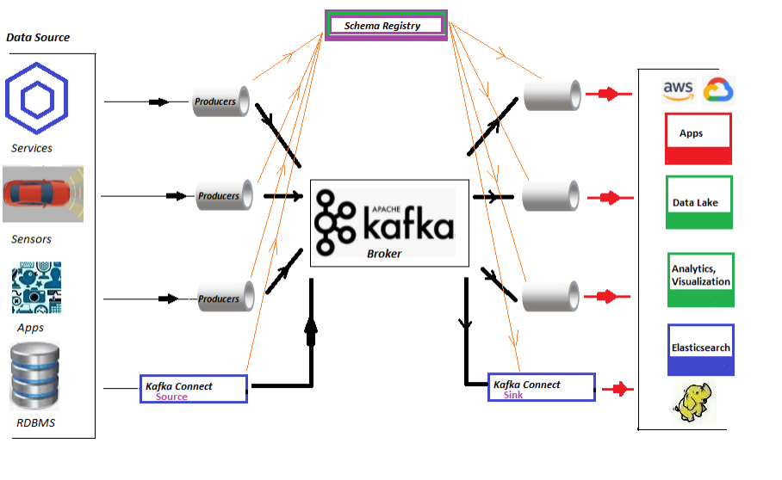
Kafka high level architecture

Slide 7
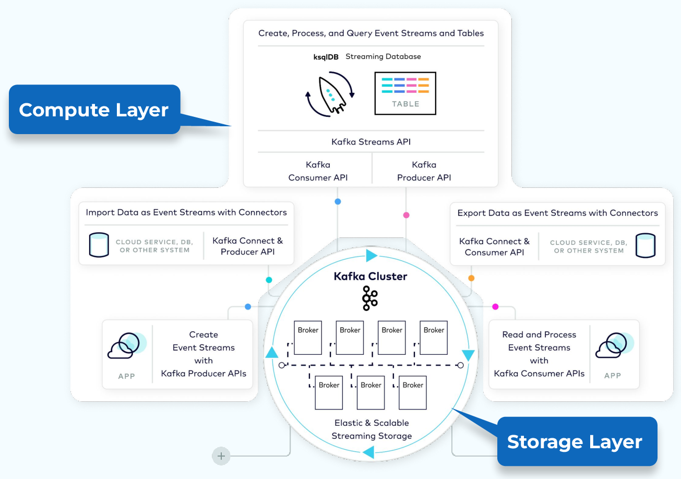
Kafka High Level Architecture

Slide 8
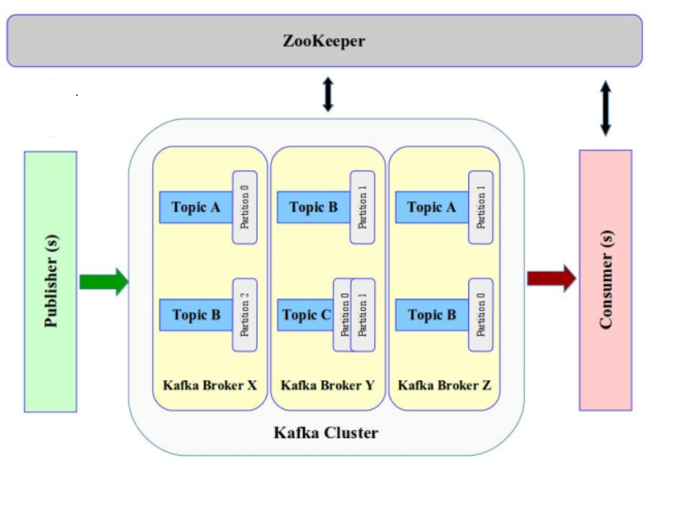
Kafka High Level Architecture

Slide 9
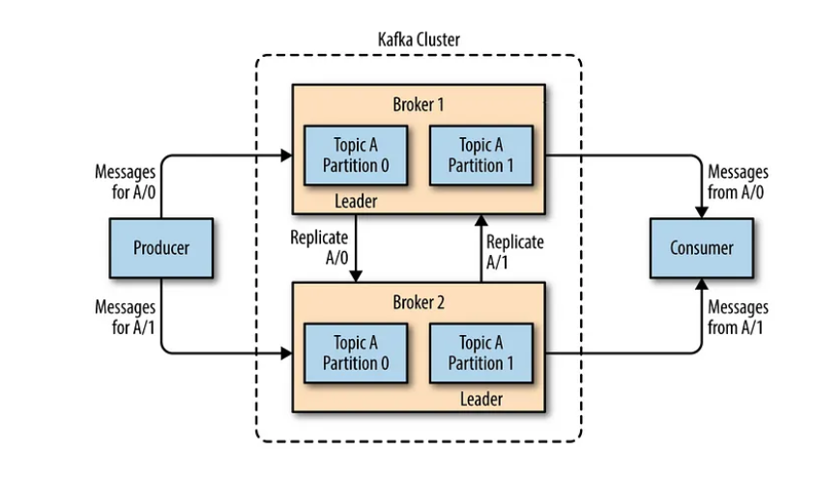
Topic partitions

Slide 10
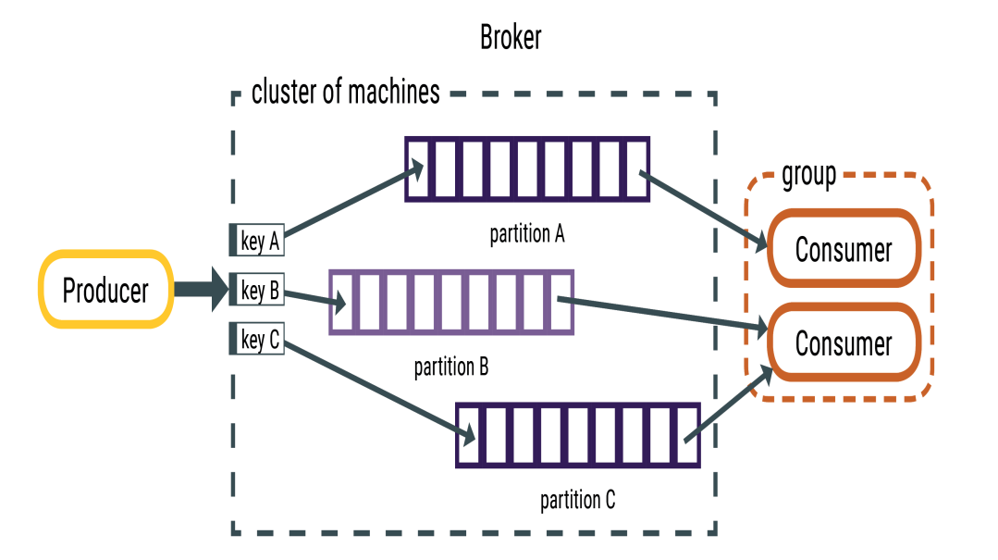
Partitioning

Slide 11
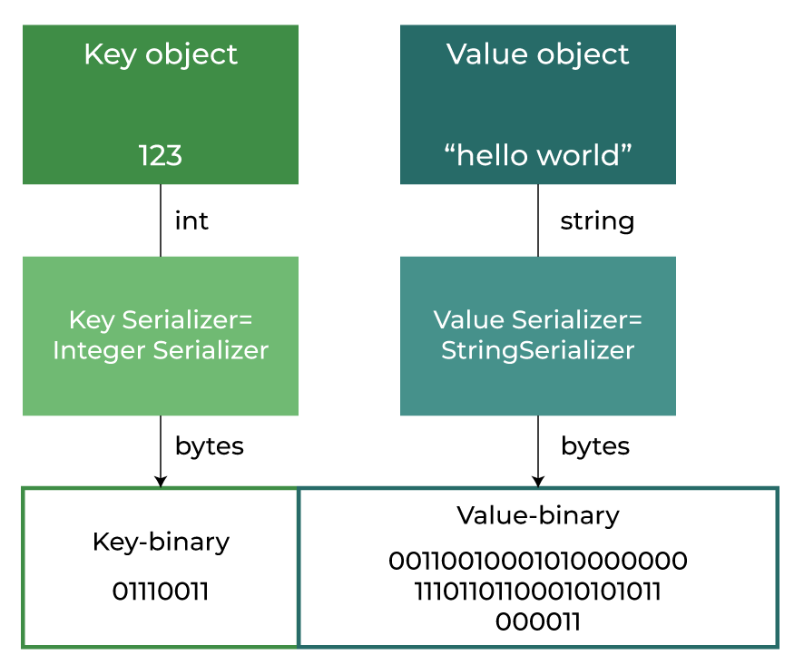
Serialization

Slide 12
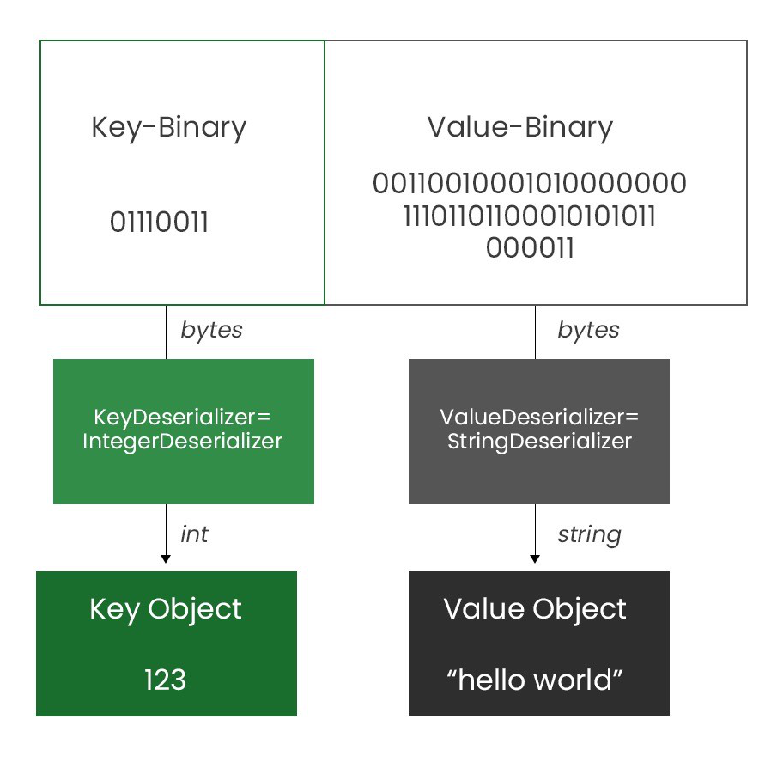
Deserialization

Slide 13
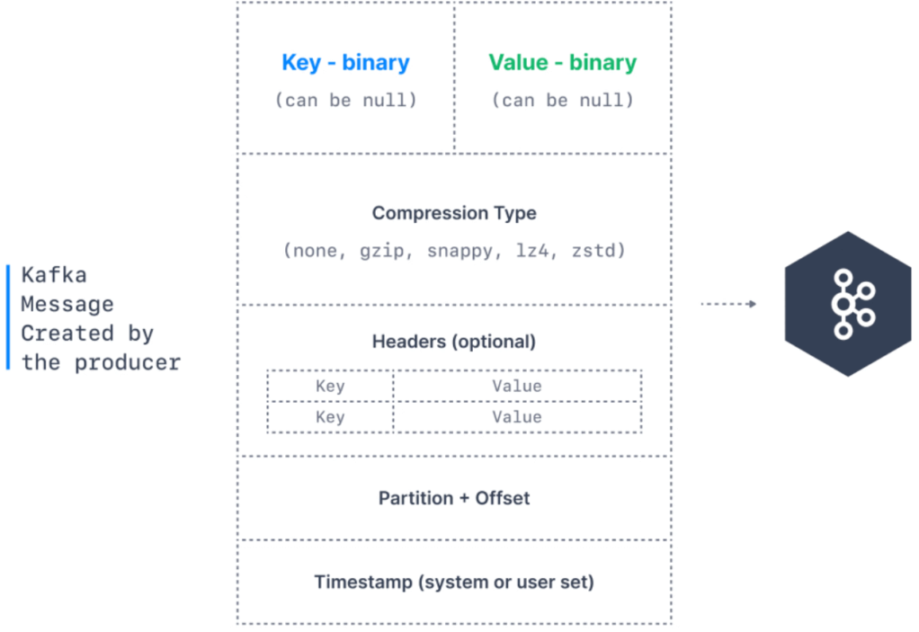
Kafka Producer Message Fromat

Slide 14
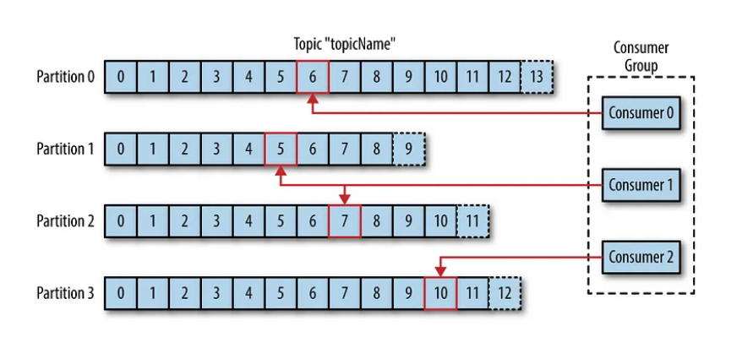
Message Offset and Consumer Group

Slide 15
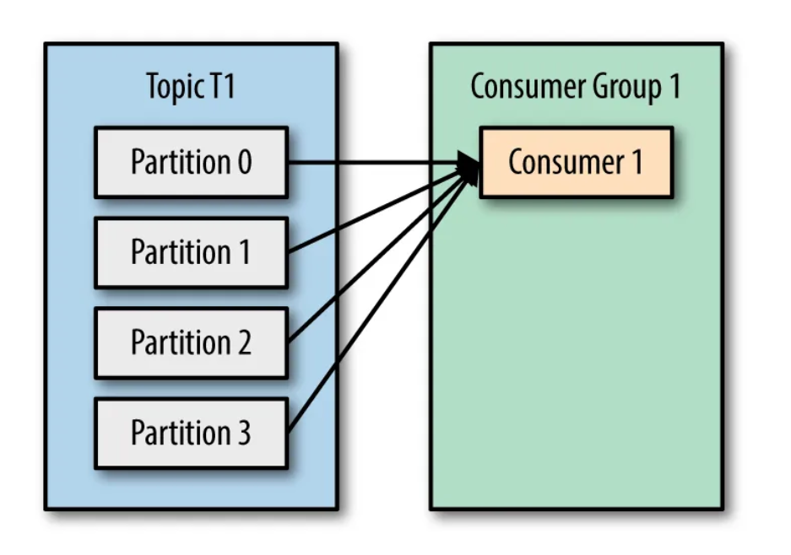
Consumer Group – partition assignment

Slide 16
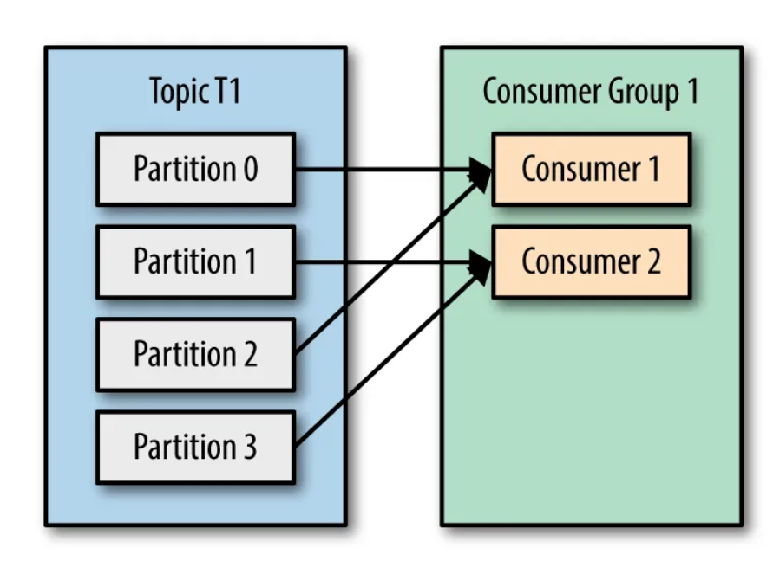
Consumer Group – partition assignment

Slide 17
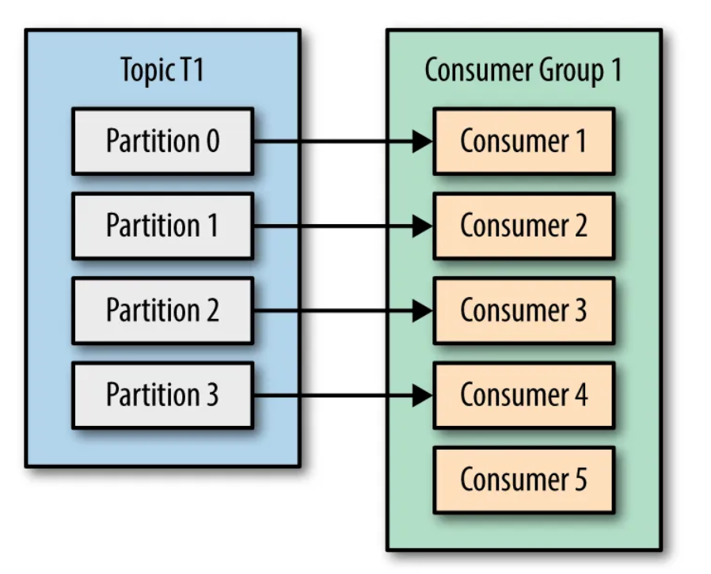
Consumer Group – partition assignment

Slide 18
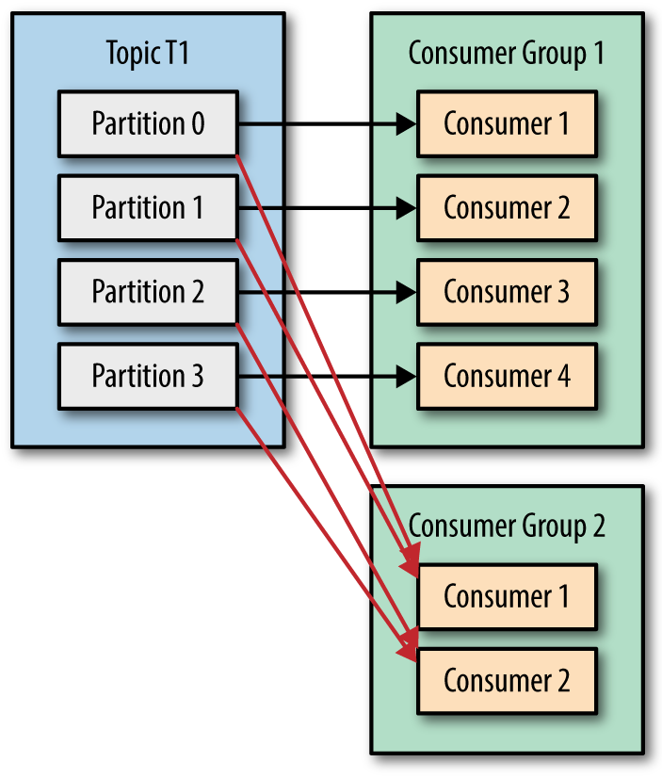
Consumer Group – partition assignment

Slide 19
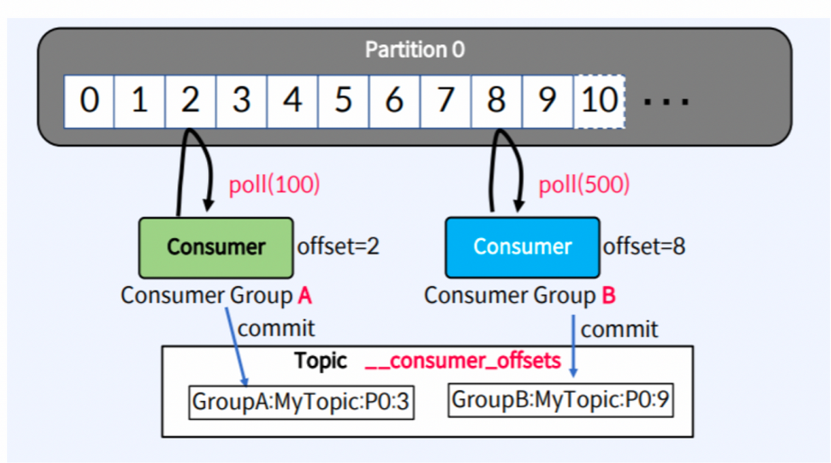
Kafka Consumer Message Pooling

Slide 20
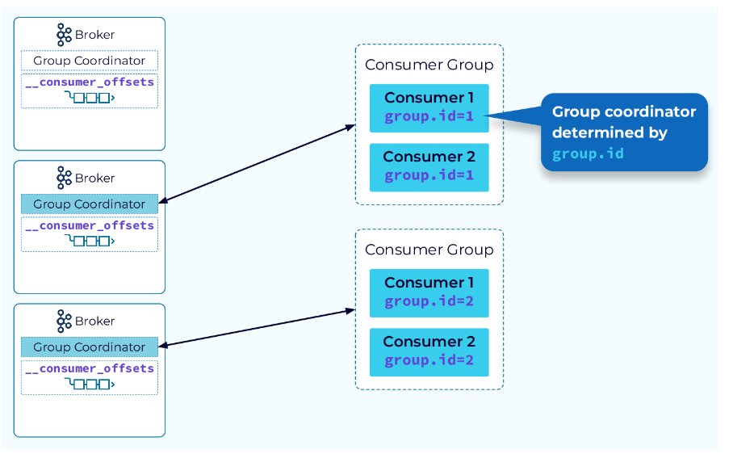
Group Coordinator

Slide 21
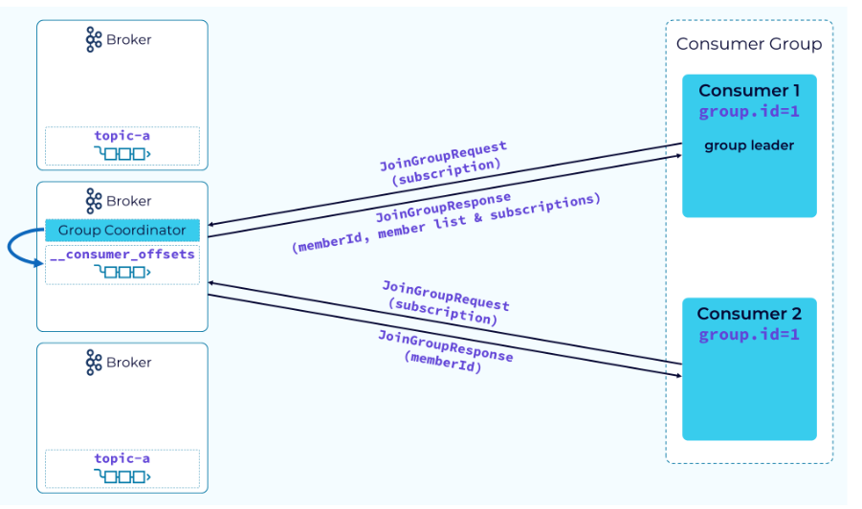
Group Leader

Slide 22
Group Leader vs. Group Coordinator
Group Leader:
The group leader is responsible for coordinating the partition assignments among the members of the consumer group.
When a consumer group is rebalanced (e.g., when a new consumer joins or leaves the group), the group leader facilitates the negotiation process to redistribute the partitions among the group members.
The group leader is chosen dynamically by Kafka based on certain criteria such as consumer ID and group membership metadata stored in Apache Zookeeper.
The leader ensures that the partition assignments are fair and balanced across the consumers in the group.
Group Coordinator:
The group coordinator is a broker responsible for managing the state of consumer groups and coordinating group-related operations.
It acts as the central point of contact for consumer group metadata and handles tasks such as joining and leaving groups, committing offsets, and detecting consumer failures.
Each consumer group has its own group coordinator, which is dynamically elected by Kafka from among the available brokers in the cluster.
The group coordinator maintains metadata about consumer groups, monitors consumer health, and handles administrative tasks related to group management.

Slide 23
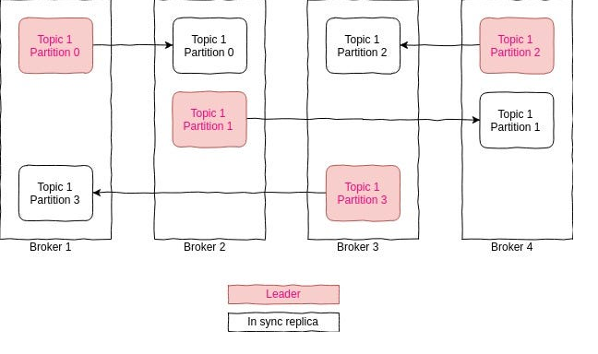
Replication Factor and In-Sync Replicas

Slide 24
Role of Apache ZooKeeper in Apache Kafka
Cluster Coordination:
ZooKeeper serves as a distributed coordination service for Apache Kafka clusters.
It maintains metadata about brokers, topics, partitions, and consumer groups, ensuring consistency and coherence across the cluster.
Broker Registration:
Kafka brokers register themselves with ZooKeeper upon startup.
ZooKeeper maintains a list of active brokers, their endpoints, and other relevant metadata, facilitating cluster discovery and communication.
Leader Election:
ZooKeeper coordinates leader election for topic partitions among Kafka brokers.
It ensures that each partition has a leader broker responsible for handling read and write requests, maintaining high availability and fault tolerance.
Consumer Group Management:
ZooKeeper tracks the membership and state of consumer groups.
It stores metadata about active consumers, their partition assignments, and offset commits, enabling reliable and scalable group coordination.
Health Monitoring:
ZooKeeper monitors the health and liveness of Kafka brokers and consumers.
It detects failures, timeouts, and network partitions, triggering appropriate actions such as leader re-election or consumer rebalancing.
Dynamic Configuration:
Kafka clusters can dynamically update their configurations using ZooKeeper.
ZooKeeper stores and distributes configuration changes, ensuring consistency and synchronicity across the cluster.
Scalability and Reliability:
ZooKeeper's distributed architecture ensures scalability and reliability.
It employs consensus protocols (e.g., ZAB) to maintain consistency and fault tolerance, even in the presence of network partitions or node failures.

Slide 25
Processing semantics
At-most-once: In at-most-once processing, messages may be delivered to consumers at most once, meaning that messages may be lost but are never duplicated. This processing semantics prioritizes minimizing duplicates but may result in potential message loss if delivery failures occur.
At-least-once: At-least-once processing ensures that messages are delivered to consumers at least once, meaning that messages may be duplicated but are never lost. This processing semantics prioritizes message delivery reliability but may result in potential duplicates if delivery failures occur and messages are reprocessed.
Exactly-once: Exactly-once processing guarantees that messages are processed exactly once by consumers, meaning that messages are neither lost nor duplicated. This processing semantics ensures both message delivery reliability and deduplication, providing stronger guarantees for data integrity and consistency.
These processing semantics represent different trade-offs between message delivery reliability, message duplication, and potential message loss. The choice of processing semantics depends on the specific requirements and use cases of the Kafka application, considering factors such as data consistency, latency requirements, and fault tolerance considerations.

Slide 26
Kubernetes Fundamentals

Slide 27
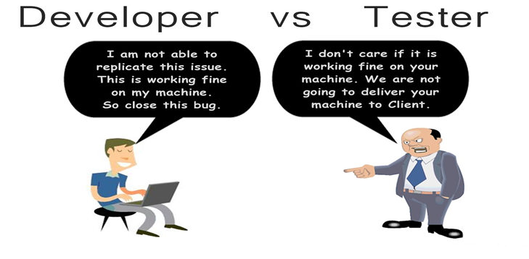

Slide 28
What is Kubernetes?
Kubernetes, often abbreviated as K8s, is an open-source container orchestration platform designed to automate the deployment, scaling, and management of containerized applications.
Key Features:
Container Orchestration: Kubernetes automates the deployment, scaling, and management of containerized applications, providing a platform for running and managing distributed systems at scale.
Service Discovery and Load Balancing: Kubernetes provides built-in mechanisms for service discovery and load balancing, allowing applications to communicate with each other seamlessly and distributing traffic across multiple instances.
Self-Healing: Kubernetes automatically detects and replaces failed containers or nodes, ensuring that applications remain available and responsive even in the event of failures.
Horizontal Scaling: Kubernetes supports horizontal scaling of applications, allowing them to dynamically scale up or down based on demand, ensuring optimal resource utilization and performance.
Rolling Updates and Rollbacks: Kubernetes facilitates rolling updates and rollbacks of application deployments, enabling continuous delivery and ensuring smooth transitions between different versions of applications.

Slide 29
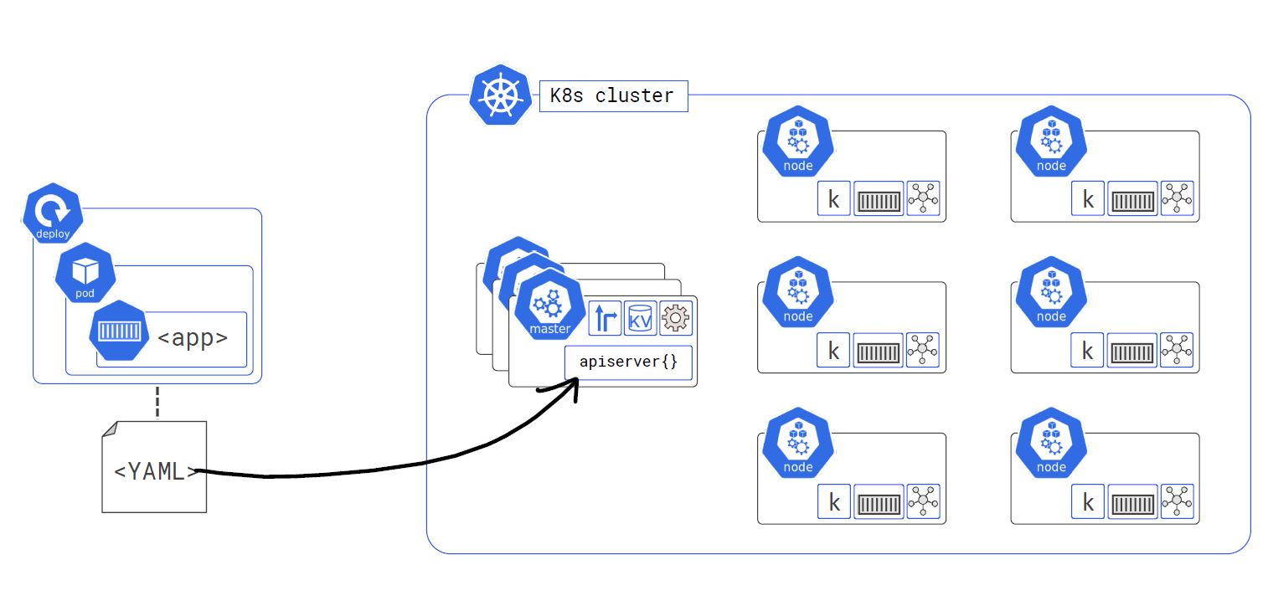
Kubernetes Architecture

Slide 30
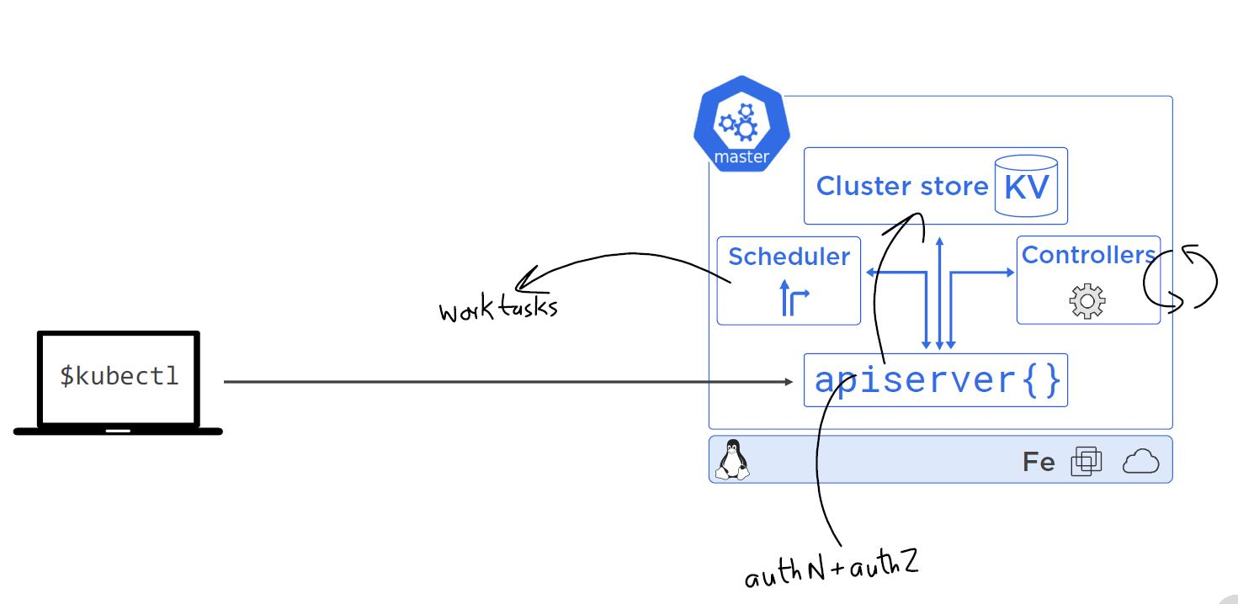
Master Nodes

Slide 31
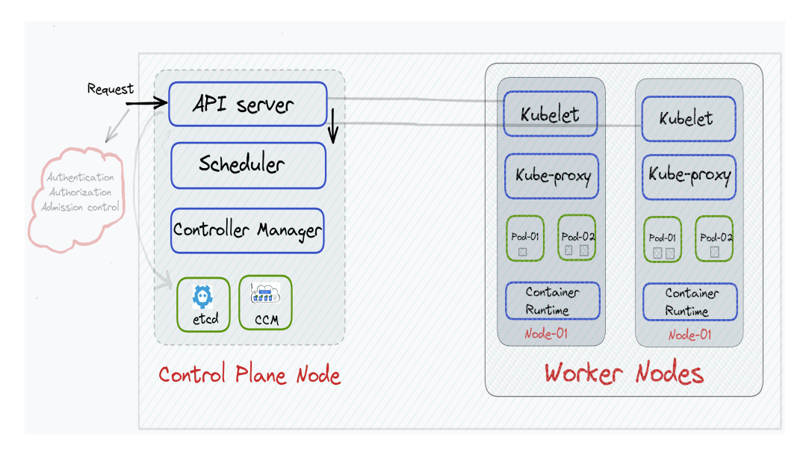
Worker Nodes

Slide 32
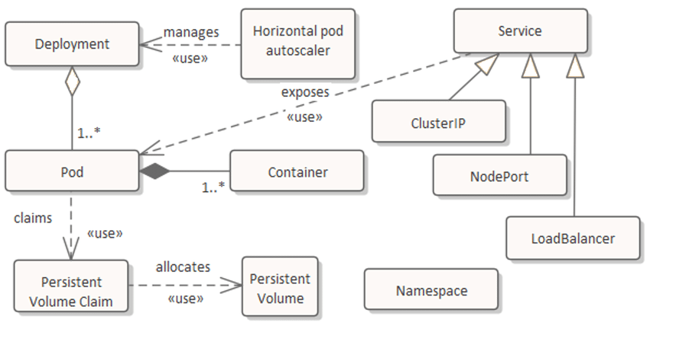
K8s Basic Resources

Slide 33
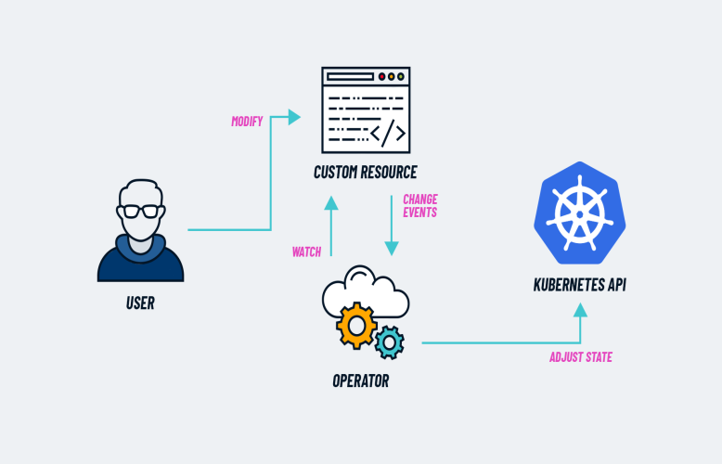
K8s Operator

